Slide 1

Verification and Validation of Safety and Security Requirements In Autonomous Vehicle
ECE 5734- Embedded System Verification & Validation
Project – Abstract
Presented By
Cory Ness
Kokila Subramanian
Under the Guidance of
Professor Ramesh Sethu

Slide 2
Introduction- Autonomous Vehicle
Autonomous vehicles – complex intelligent system
Integration of sensors, radars, camera, Central computer and electromechanical components
Adoption of AV’s can reduce 90% vehicle crashes every year
Common Principles of Automated Driving
Safe Operation
Safety Assessment
Security
Data Recording
Interdependency between Vehicle Operator and Operational design
User Responsibility

Slide 3
Society of Automotive Engineers (SAE) – Automation Levels
LEVEL 0
No automation
Driver Performs all driving Tasks
LEVEL 1
Drive Assistance
Vehicle is controlled by driver
LEVEL 2
Partial Automation
Combined automation functions like acceleration and steering, with the engagement of driver task to monitor environment
Some driving assistant features added to design
LEVEL 3
Conditional Automation
Driver need to take control in case of emergency
LEVEL 4
High automation
Vehicle capable of performing driving, while driver can take control under certain conditions
LEVEL 5
Full Automation
Vehicle capable of preforming all driving functions

Slide 4
Safety Requirements
Environment Perception Sensors and map attributes to predict if automated vehicle exceeds specific system limits
Perceive relevant static and Dynamic Objects in Proximity
Combines data from Environment Perception sensors, and traffic rules
Predict Future Behavior of Surrounding Objects
Create Collision Free and Lawful Driving Plan
Involves Interpretation and Prediction, Traffic information, and ADS Mode Manager to create driving plan
Derive Driving plan and motion control with secondary actuators based on interaction with surrounding elements
Interpretation and prediction using collected data
Execute and Actuate right Driving Plan
Combines Driving Plan and Egomotion to control Motion actuators.
Communication with other Road users
Ensure Controllability of Vehicle
Vehicle and user state definition obtained from human- machine interaction controls the ADS manager
Determine Location

Slide 5
Potential Security Attacks
Cyber Security Threats
Denial-of Service Attacks, remote access and control ,man-in-the –middle attacks, etc.
Software Glitches
Integration of million lines of code create opportunity for bugs and mistakes
No single source of Knowledge on source Code
Software for different components are developed by different developers. No control over the source code
Threats in connected AV’s increases risk to life and property
Increases Use of Apps Leave Vulnerabilities
Increased number of consumer apps with connected cars can cause weakness to the system
Need for Constant Updates
The increased use of connected features increases need for continuous updates to fix glitches.

Slide 6
Objective
To develop an autonomous Vehicle model based on physics that simulate sensors for velocity & distance measurement, lane centring for cruise control using LabVIEW simulation tool.
To identify, verify and validate the functional requirements of the Autonomous vehicle model with respect to safety and security metrics defined reliant on SAE Automation Levels.
Safety requirement analysis is made based on hazard analysis, lane control, automatic braking system and accidental failures.
Security requirements are analysed based on the threat and risk assessments

Slide 7
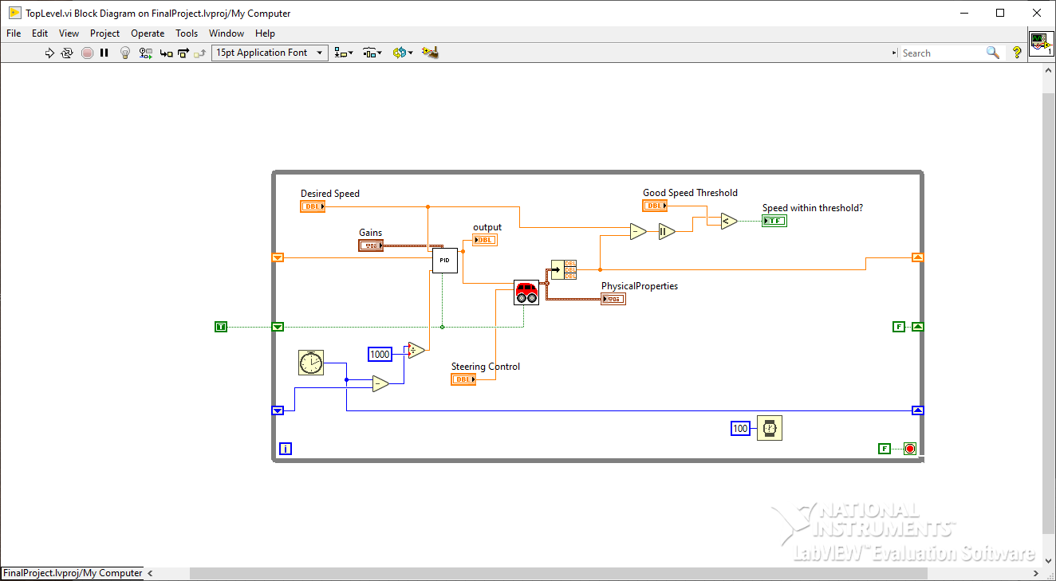
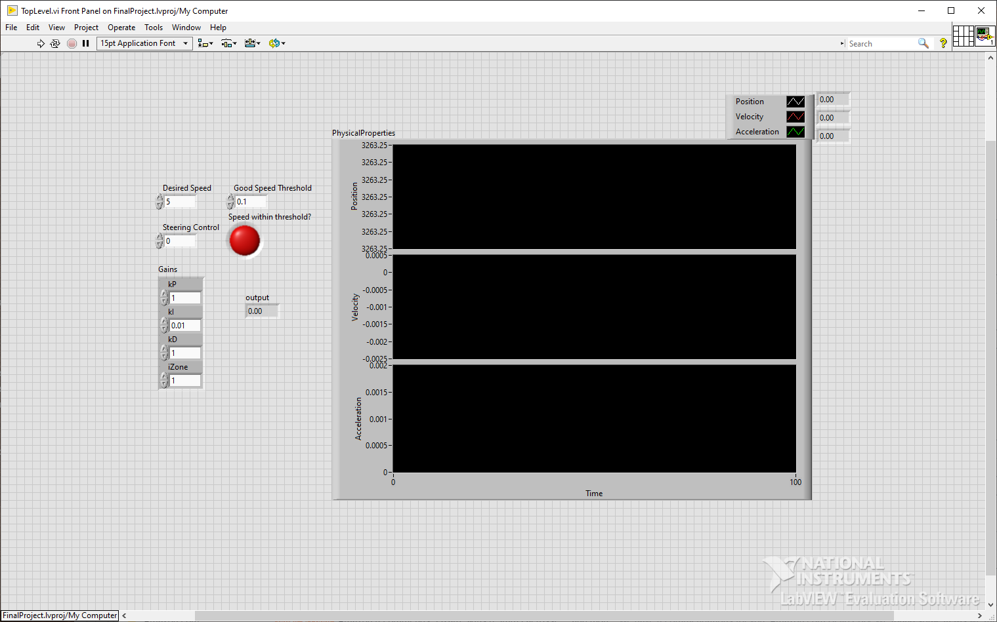
Autonomous Vehicle Model- LabVIEW
Uses a kinematic approach
Simplified model based on existing complex models from papers such as “Kinematic and Dynamic Vehicle Models for Autonomous Driving Control Design”, “On controllability and trajectory tracking of a kinematic vehicle model”, and “Multirate Lane-Keeping System With Kinematic Vehicle Model”.
Calculates Acceleration, Velocity, and Position continuously which is then compared against in the verification and validation program to ensure it’s within constraints

Slide 8
Simulation Tool- LabVIEW
Visual-based programming language where you wire inputs into outputs to construct the program.
Easy to create inputs and outputs to verify the program does what it’s supposed to.
Easy to create models using built-in tools language features and easy debugging.
Very easy to create a front dashboard that reports the status of the verification and validation tests.

Slide 9
Project- Work Flow
Identify Possible safety and Security requirements of AV’s
Develop AV model based on physics in LabVIEW simulation tool
Simulate real-time sensor models to preform automated driving capability
Verify safety properties of AV model such as automatic braking, lane control, and acceleration control in acceptance with SAE Standard
Verify security requirements

Slide 10
References
Ailon, A., Berman, N., & Arogeti, S. (2005). On controllability and trajectory tracking of a kinematic vehicle model. Automatica, 41(5), 889–896. https://doi.org/10.1016/j.automatica.2004.11.025
Benz: Safety First for automated driving. Mercedes. (2019, July 4). https://www.mercedes-benz.com/en/innovation/safety-first-for-automated-driving/?csref=sm_fbk_gims2019_pc.html
Kang, C. M., Lee, S.-H., & Chung, C. C. (2018). Multirate Lane-keeping system with kinematic vehicle model. IEEE Transactions on Vehicular Technology, 67(10), 9211–9222. https://doi.org/10.1109/tvt.2018.2864329
Kong, G., Pfeiffer, Mark., Schildbach, G., and Borrelli, F. Kinematic and dynamic vehicle models for Autonomous Driving Control Design. IEEE Xplore. (n.d.). https://ieeexplore.ieee.org/document/7225830
Sabaliauskaite, G., Liew, L., & Cui, J. (1970, January 1). [PDF] Integrating Autonomous Vehicle Safety and security analysis using STPA method and the six-step model: Semantic scholar. undefined. https://www.semanticscholar.org/paper/Integrating-Autonomous-Vehicle-Safety-and-Security-Sabaliauskaite-Liew/dcc9ab963f2f4d97b5dc81d0e8df0708008d36a8

